Slide 1
Python Assignment 1 – Mar21
Agenda
Discussion: Emoji Equity
Python Assignment 1
Hardcopy Answers
Begin Today / Complete Tomorrow
Upcoming
Ongoing:
Tomorrow: Finish Python Assignment

Slide 2
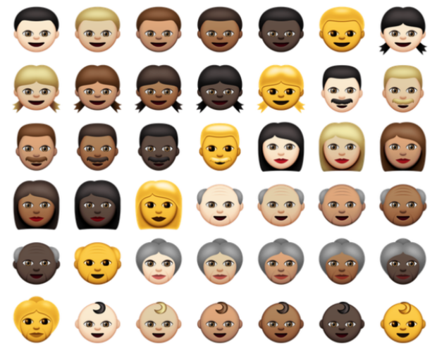
Emoji Equity
Point 1: "Emojis are replacing words in on-line communities."
Point 2: "Emojis are not representative of diversity in on-line communities."

